Slide 1






AirSential
Advanced Smart Device for Air Quality Monitoring, Gas Leak Detection, and Emergency Response-
Safeguarding Respiratory Health with Intelligent Hazard Prevention
By Sagarika Srivastava

Slide 2
This advanced device is designed to assist individuals with respiratory illnesses while enhancing safety in homes and offices. It features real-time air quality monitoring and gas leak detection, with intelligent systems to differentiate between harmless smoke (such as from incense or cigarettes) and dangerous smoke or gas leaks. Equipped with a small camera for human face detection and integrated smoke and gas alarms, the device covers large areas efficiently. It can automatically alert authorities in case of prolonged hazardous gas levels or fire emergencies, ensuring timely intervention.

Slide 3

FUNCTIONS OF MY DEVICE
•SENSOR TO DETECT AIR QUALITY AND CONTENTS PERCENTAGE WISE
O2-% CO2-% ETC
•LIGHT FOR INDICATION (RED YELLOW GREEN)
•DISPLAY AIR QUALITY
•ALARMING SYSTEM IN CASE OF FIRE
•LARGE RADIUS
•CAN TELL THE DIFF BETWEEN ACTUAL SMOKE AND A PERSON SMOKING
•WIFI connectivity
•RUNS ON BATTERY FOR POWER SUPPLY
•ECONOMICAL
•All combined in one single device that can be hanged on the wall

Slide 4
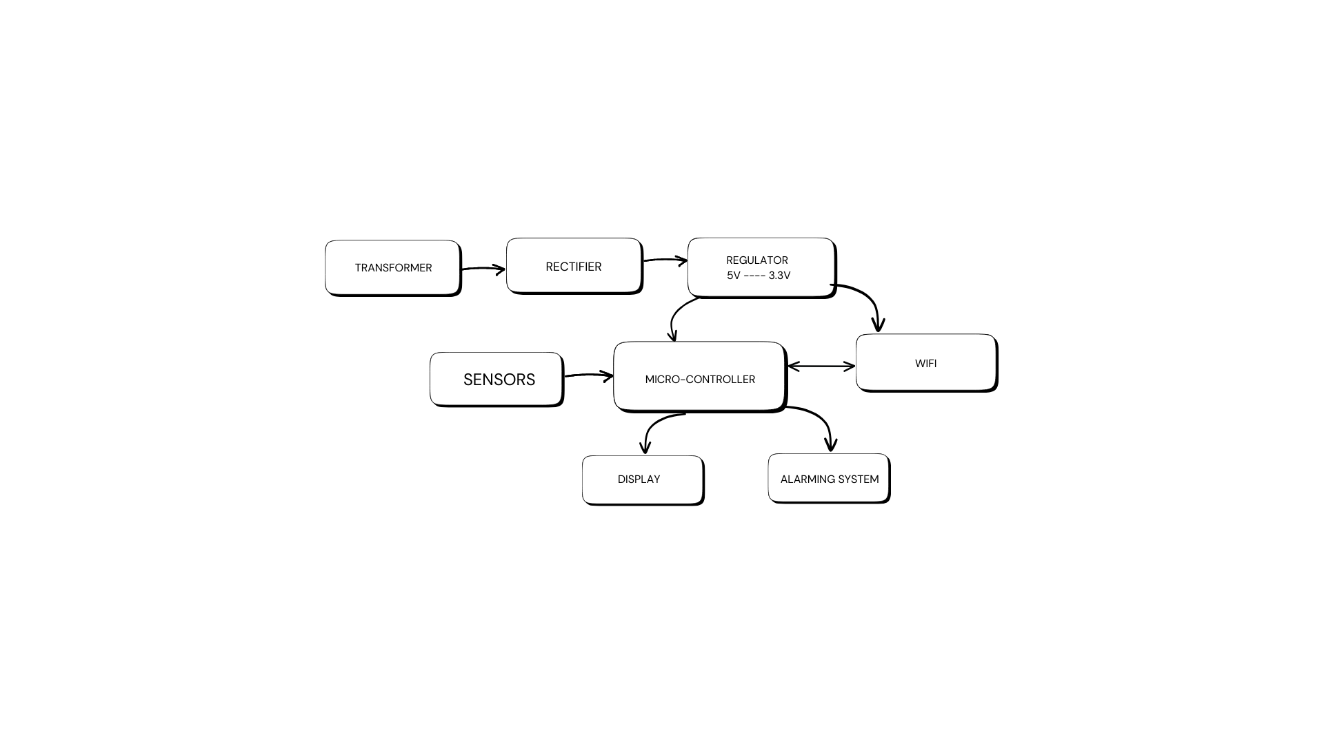
Sample Circuit Block Diagram

Slide 5


COMPONENTS
1. Microcontroller
2. Wi-Fi Module
3. LCD Display
4. DC Fan
5. Diodes
6. IC && IC Sockets
7. Regulator
8. Transformer
9. Sensor
10. Capacitors
11. Transistors
12. Breadboard /cables /wires /PCB /switch /push buttons
13. Potentiometer
14. Buzzer
15. Resistors
16. crystal Oscillator
17. LEDs

Slide 6

What Gases will be detected
1.Carbon Dioxide CO₂
2.Oxygen O2
3.Carbon Monoxide CO
4.Hydrogen Cyanide HCN - Zyklon B
3.Hydrogen Sulfide H₂S
5.Phosgene COCl₂
6.Chlorine Gas Cl₂
7.Ammonia NH₃
8.Nitrogen Oxides NOx
9.Nitrogen Dioxide NO₂
10.Sulfur Dioxide SO₂

Slide 7
9.Methane CH₄
10.Inert Gases
-Helium He
-Argon Ar
-Nitrogen N2
10.Nerve Agents(Chemical Warfare Gases)
-Sarin(GB)
-VX
-Soman (GD)
-Tabun (GA).
11.Liquefied Petroleum Gas (LPG)
Composition: Primarily propane (C₃H₈) and butane (C₄H₁₀).
12. Natural Gas
Composition: Mostly methane (CH₄), with small amounts of ethane, propane

Slide 8


Increase Precision of the device
Sensors
Differnt Sensors combined using Sensor Fussion for more accuracy and detection
GAS SENSORS
FIRE/SMOKE SENSOR
TEMPERATURE SENSOR
RAIN/HUMIDITY SENSOR
PIR SENSOR
With multiple sensors present the detection of severity of situation is found i.e. Smoke generated from a wild fire and smoke gfrom a cigratte is properply recognised and alerting system is activated accordingly

Slide 9

Alerting System
With wi-fi connectivity internet is accesible and therefore the right person / authority can be alerted
GPS can help with location
While the microcontroller will be able to set the range of emergency from 1-10 which will help authorities determine the level of severity and take necessary actions to prevent accidents.
Emergency Buzzer will help the resident and thier neighbours to be informed about danger
if a gas leakage happens when resident is not present these automatic alerting system can be very useful.

Slide 10
DISPLAY
Air Quality can help in detection of pollution and provide a comparision of pollution/air quality in different areas
Red-Yellow-Green light indicator can help in showing severity to a person from non-technical backgrounds, kids, senior citizens etc.
Detection of poisonus gases can help in preventing many severe accidents

Slide 11

Thank You

